Slide 1

DATA - THE FOUNDATION OF BUSINESS ANALYTICS
DATA REFERS TO RAW FACTS, OBSERVATIONS, MEASUREMENTS, OR VALUES COLLECTED FROM VARIOUS SOURCES THAT CAN BE PROCESSED TO OBTAIN MEANINGFUL INFORMATION.
EXAMPLES
CUSTOMER AGE
PRODUCT PRICE
EMPLOYEE SALARY
CUSTOMER FEEDBACK
PRODUCT RATING
AN ONLINE SHOPPING WEBSITE COLLECTS:
CUSTOMER NAME
AGE
GENDER
PRODUCT PURCHASED
PAYMENT METHOD
RATING

Slide 2

WHY UNDERSTANDING DATA TYPES IS IMPORTANT?
Different types of data require different analytical techniques.
Importance
Helps choose appropriate statistical methods
Improves data visualization
Supports better decision-making
Increases prediction accuracy
Reduces analysis errors
01

Slide 3


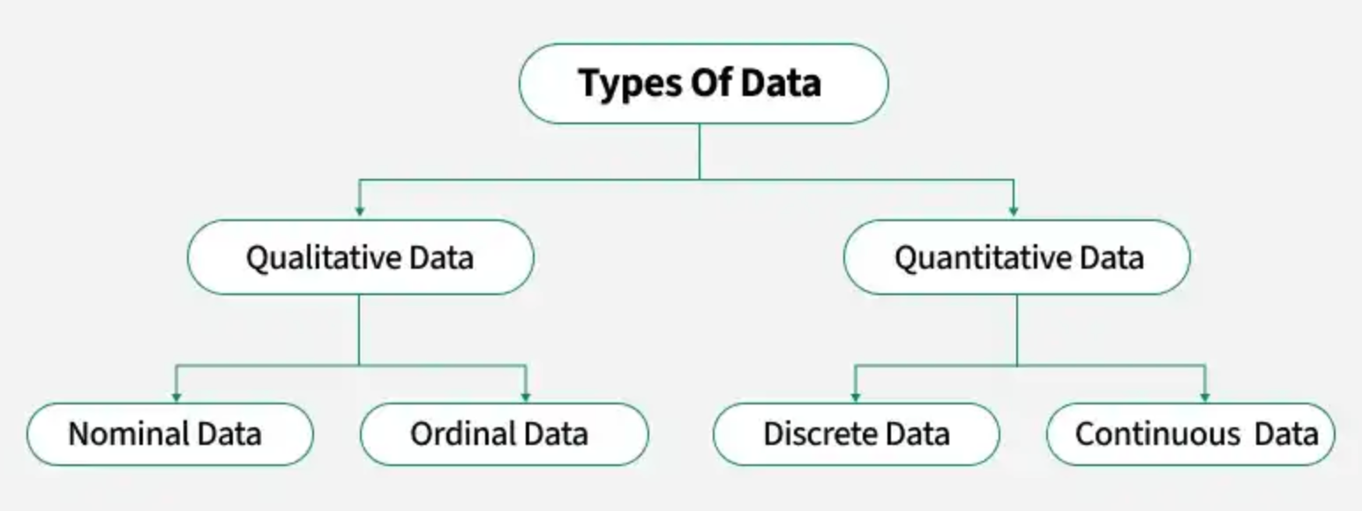

CLASSIFICATION OF DATA
02

Slide 4
QUALITATIVE DATA (CATEGORICAL DATA)
Qualitative data describes characteristics, categories, or attributes rather than numerical values.
Examples
Gender
Blood Group
City
Product Category
Customer Satisfaction
Payment Mode
Characteristics
Non-numeric
Represents qualities
Used for classification
03

Slide 5

TYPES OF QUALITATIVE DATA
Nominal Data
Categories without any order.
Examples
Gender
Blood Group
Country
Color
Ordinal Data
Categories with a meaningful order.
Examples
Poor
Average
Good
Excellent
04

Slide 6
QUANTITATIVE DATA (NUMERICAL DATA)
Quantitative data consists of numerical values that can be measured or counted.
Examples
Age
Height
Weight
Income
Sales
Temperature
Characteristics
Numeric
Mathematical operations possible
Used for statistical calculations
05

Slide 7
TYPES OF QUANTITATIVE DATA
Discrete Data
Countable values.
Examples
Number of Employees
Number of Students
Cars Sold
Mobile Phones Purchased
Continuous Data
Measured values.
Examples
Height
Weight
Temperature
Time
Distance
06

Slide 8
QUALITATIVE VS QUANTITATIVE DATA
Qualitative Data | Quantitative Data
Descriptive | Numerical
Cannot be measured | Can be measured
Categories | Numbers
Example: Gender | Example: Age
Example: City | Example: Salary
07

Slide 9
REAL BUSINESS ANALYTICS EXAMPLE
Customer | Age | Gender | City | Purchase Amount
A | 25 | Female | Delhi | ₹1500
B | 32 | Male | Mumbai | ₹2500
C | 28 | Female | Jaipur | ₹1800
Ques 1: Which columns are Qualitative?
Ques 2: Which are Quantitative?
08

Slide 10

THANK YOU

